Slide 1
Pine Ridge Alert
Planning for extension of the Florida turnpike has resumed. Some options will impact Pine Ridge.
FDOT is hosting two evening meetings (5:30 to 7:30 PM) on the campuses of the Collage of Central Florida.
Chiefland on Dec 7th
Lecanto on Dec 9th.
Attendance can be in person or virtual. Registration is at:
https://floridasturnpike.com/turnpike-projects/featured-projects/northern-turnpike-extension/
This FDOT Project # 14480 has interactive maps that can be viewed at:
https://etdmpub.fla-etat.org/est/#
In the upper left box enter the project 14490 then click on the “view on map’ icon. You can then zoom in and out.

Slide 2
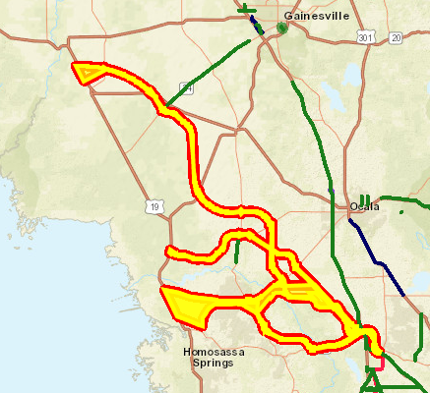
The areas in yellow are the four routes and end points under consideration.
Route 14480-1 – Sumpter/Marion to North of Chiefland
Route 14480-2 – Sumpter/Marion to North of Inglis
Route 14480-3 – Sumpter /Marion down SR 200 through Crystal Springs to north of Crystal River
Route 14480-4 – SR44 to north of Inverness to Hernando then through Crystal Springs to north of Crystal River
1->
2->
<-3
4->

Slide 3
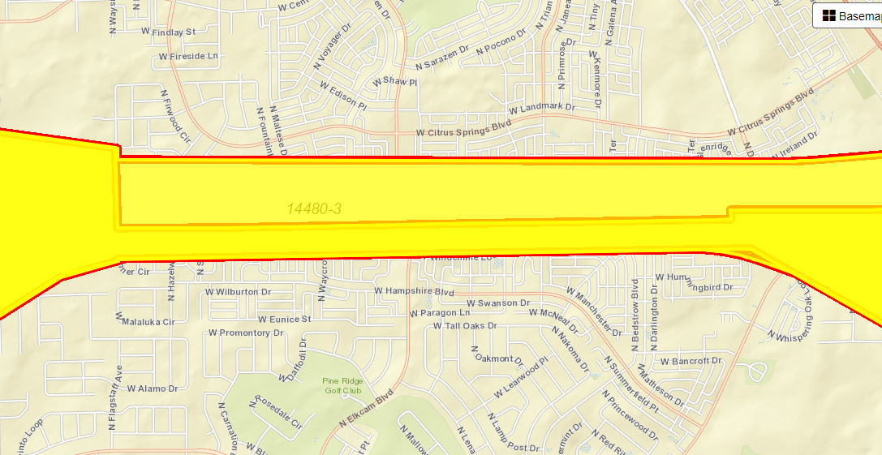
W Citrus Springs Blvd.
<-3->
<-4->
W Hampshire Blvd.
Elkcam Blvd.

