Slide 1
PRPOA – Corner Lots
Purpose of Presentation
Explain the process of Identifying
Front Property Line
Front Line of the Main Structure
Rear Line of the Main Structure
Goal – provide most usable space for every Member.

Slide 2
2 Examples – Corner Lots
Simple Example
Non Parallel Corners

Slide 3
Example 1
Simple Example

Slide 4
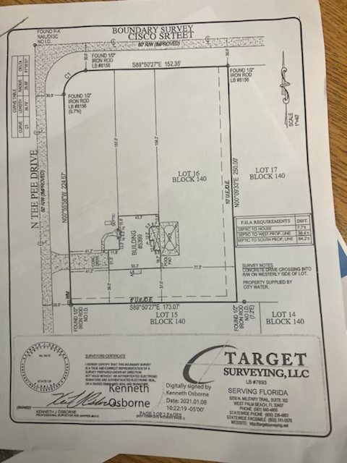

Slide 5
Identify a Street A and Street B
B
A

Slide 6
For Street A:
A

Slide 7
For Side A: Determine the two most forward corners (closest to Street A)
A

Slide 8
For Side A: extend a line through these two points out to the side property lines
A

Slide 9
This is the Front Line of the Main Structure as viewed from Street A
A

Slide 10
Determine the two most outer rear corners (closest to rear and each sides of the property) of the Main Structure, excluding pool and cage
A

Slide 11
Extend a line separately through each point parallel to the Front Line of the Main Structure out to the side property lines
A

Slide 12
This would be the rear line of the Main Structure for A
A

Slide 13
Now Do the Same Thing for street B
B

Slide 14
For Side B: Determine the two most forward corners (closest to Street )
B

Slide 15
For Side B: extend a line through these two points out to the side property lines
B

Slide 16
This is the Front Line of the Main Structure as viewed from Street B
B

Slide 17
Determine the two most outer rear corners as viewed from B(closest to rear property line and each sides of the property) of the Main Structure, excluding pool and cage
B

Slide 18
Extend a line separately through each point parallel to the Front Line of the Main Structure out to the side property lines
B

Slide 19
This would be the rear line of the Main Structure for B
B

Slide 20
Compare the area of the available space behind the rear line of the main structure for street A and Street B
B
A

Slide 21
A’s Area behind the Rear Line is obviously Larger. So property line nearest to A becomes the Front Property Line, Front Line of the Main Structure and Rear line of the Main structure
B
A

Slide 22
Example 2 – Non Parallel Corners
A case of 2 points of the main structure not forming a parallel line to the Front Line of the Main Structure

Slide 23
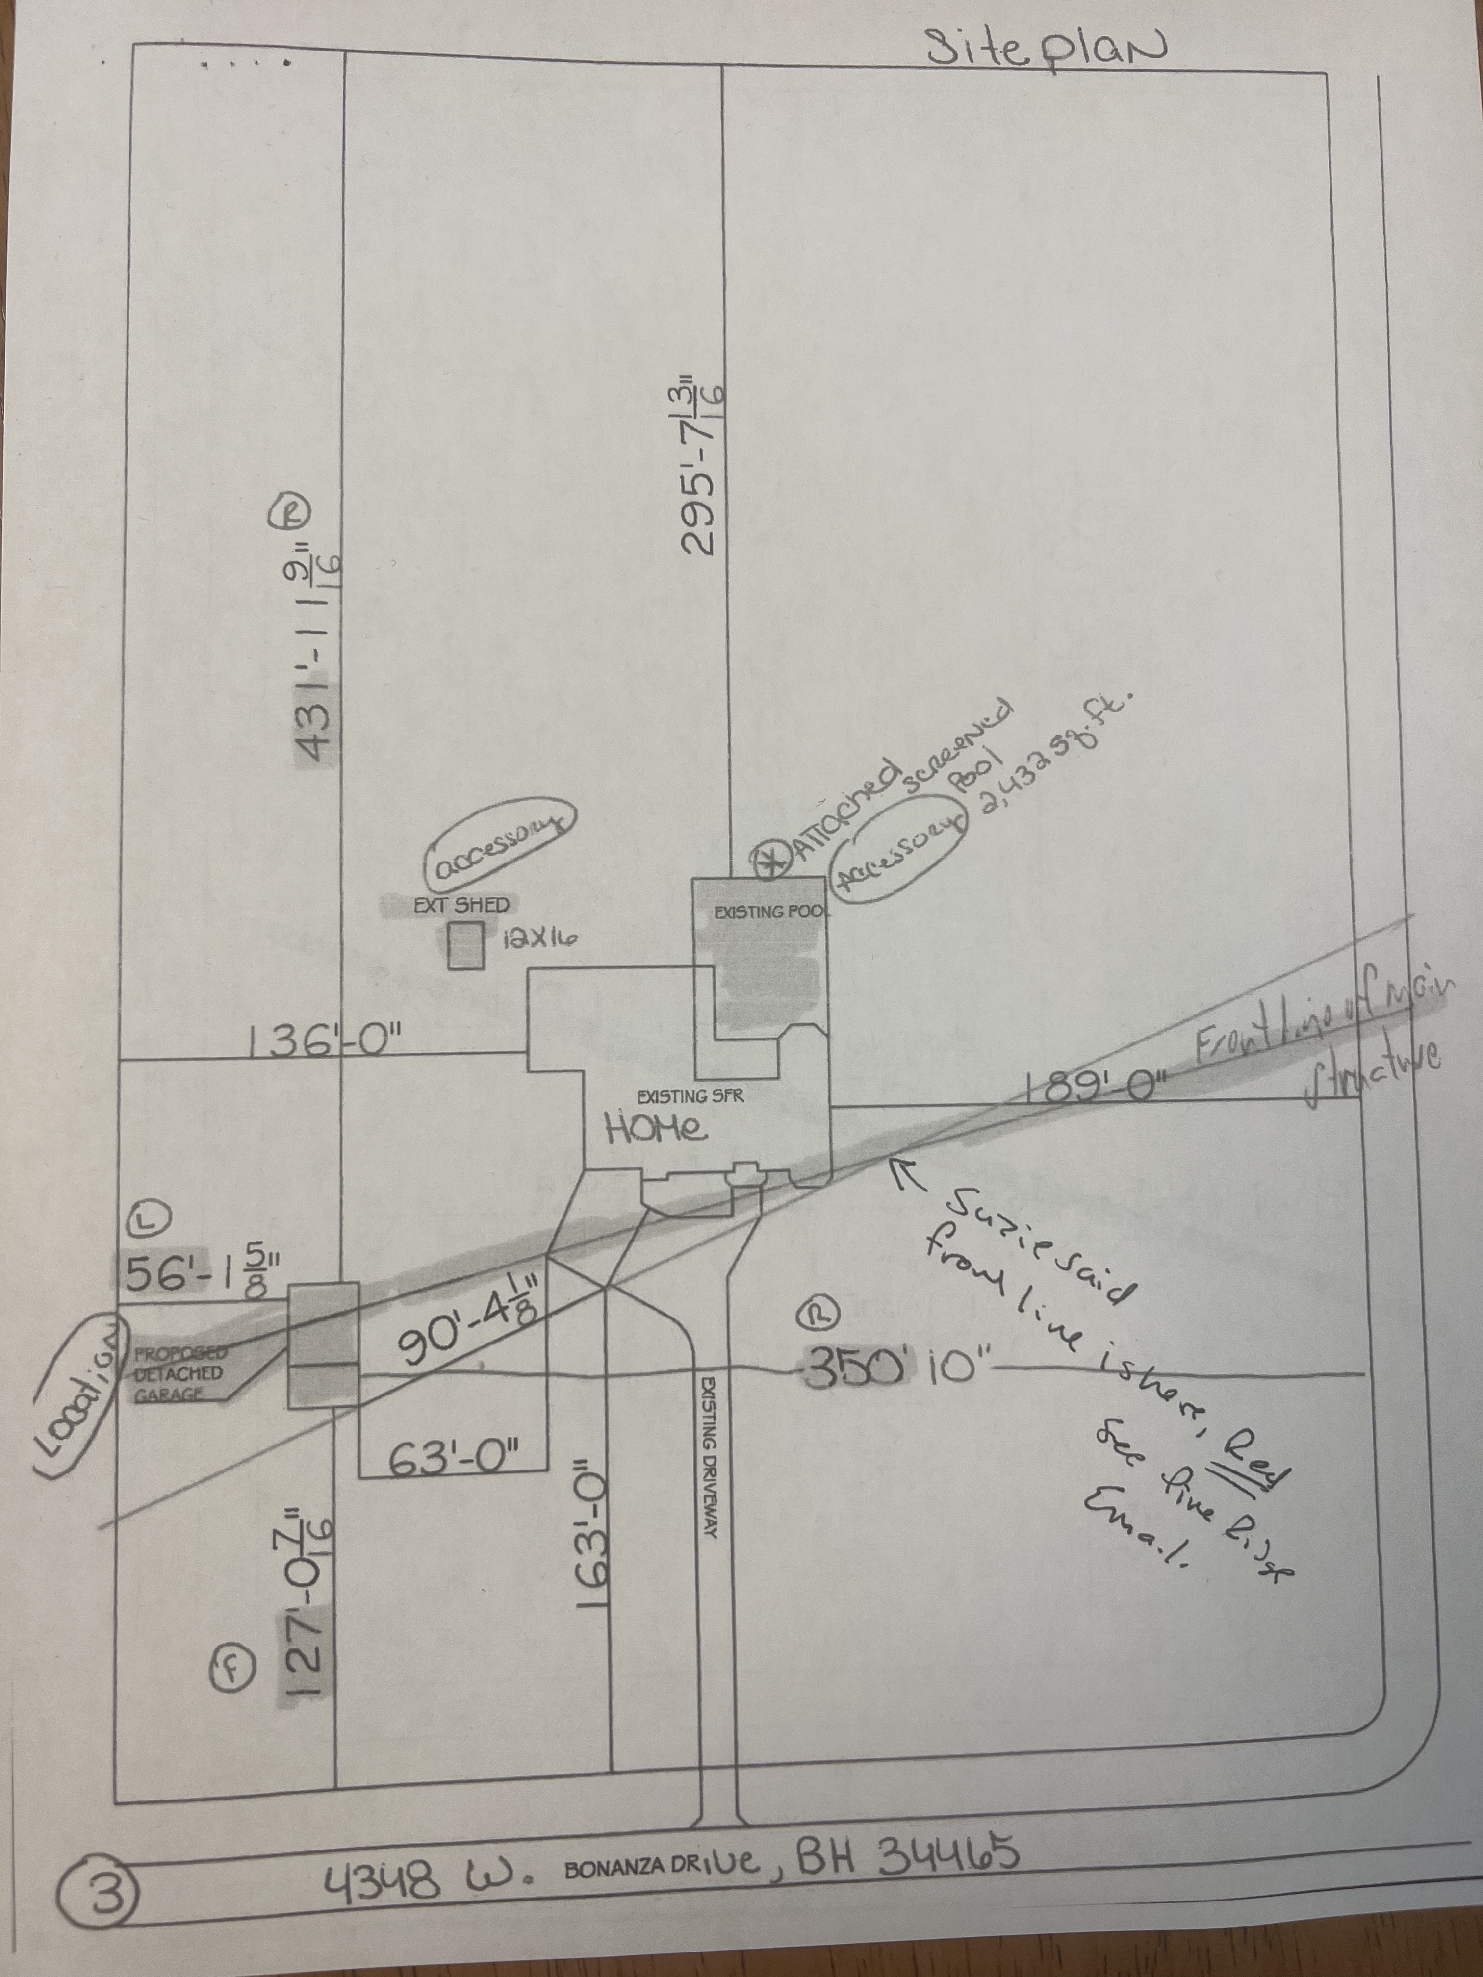
Step 1 – Identify Street A and B
A
B

Slide 24
For Street A:
A

Slide 25
For Side A: Determine the two most forward corners (closest to Street A)
A

Slide 26
For Side A: extend a line through these two points out to the side property lines
A

Slide 27
This is the Front Line of the Main Structure as viewed from Street A
A

Slide 28
Determine the two most outer rear corners (closest to rear property Line and each sides of the property) of the Main Structure, excluding pool and cage
A

Slide 29
Extend each line separately through each point parallel to the Front Line of the Main Structure out to the side property lines
A

Slide 30
The line that provides that provides the most useable land space is the Rear Line of the Main Structure for A
A
Front line of the Main Structure A
Rear line of the Main Structure for A

Slide 31
Now Do the Same Thing for street B
B

Slide 32
For Side B: Determine the two most forward corners (closest to Street )
B

Slide 33
For Side B: extend a line through these two points out to the side property lines
B

Slide 34
This is the Front Line of the Main Structure as viewed from Street B
B

Slide 35
Determine the two most outer rear corners as viewed from B(closest to rear and each sides of the property) of the Main Structure, excluding pool and cage
B

Slide 36
Extend each line separately through each point parallel to the Front Line of the Main Structure out to the side property lines
B

Slide 37
The line that provides the most useable land space is the Rear Line of the Main Structure for B
B

Slide 38
Compare the area of the available space behind the rear line of the main structure for street A and Street B
A
Front line of the Main Structure A
Rear line of the Main Structure for A
B

Slide 39
B is obviously Larger So the property line near B becomes the Front Property Line, Front Line of the Main Structure and Rear line of the Main structure
A
Front line of the Main Structure A
Rear line of the Main Structure for A
B

Slide 40
Thank you for your Time!
Any questions please contact the Office

